Slide 1
Improving Reproducibility Through Better Software Practices
Patricia Grubel (she/her) Los Alamos National Laboratory
Better Scientific Software tutorial @ Improving Scientific Software conference (2023)
Contributors: David E. Bernholdt (ORNL), Patricia Grubel (LANL), Michael A. Heroux (SNL), David M. Rogers (ORNL), Greg Watson (ORNL)
LA-UR-20-27821
Notes:
Originally a 45 minute talk, cut to about 30 by putting the Data Management Plans and Reproducibility after the summary and cutting the Psychology example and the 2 slides at the end, probably covered under testing.
To make this a 15 minute talk go through the initial examples and incentives quickly then cover the How to sections.

Slide 2

License, Citation and Acknowledgements
License and Citation
This work is licensed under a Creative Commons Attribution 4.0 International License (CC BY 4.0).
The requested citation the overall tutorial is: David E. Bernholdt, Patricia A. Grubel, and David M. Rogers, Better Scientific Software tutorial, in Improving Scientific Software, Boulder, Colorado and online, 2023. DOI: 10.6084/m9.figshare.22179748.
Individual modules may be cited as Speaker, Module Title, in Tutorial Title, …
Acknowledgements
This work was supported by the U.S. Department of Energy Office of Science, Office of Advanced Scientific Computing Research (ASCR), and by the Exascale Computing Project (17-SC-20-SC), a collaborative effort of the U.S. Department of Energy Office of Science and the National Nuclear Security Administration.
This work was performed in part at the Argonne National Laboratory, which is managed by UChicago Argonne, LLC for the U.S. Department of Energy under Contract No. DE-AC02-06CH11357.
This work was performed in part at the Lawrence Livermore National Laboratory, which is managed by Lawrence Livermore National Security, LLC for the U.S. Department of Energy under Contract No. DE-AC52-07NA27344.
This work was performed in part at the Los Alamos National Laboratory, which is managed by Triad National Security, LLC for the U.S. Department of Energy under Contract No.89233218CNA000001
This work was performed in part at the Oak Ridge National Laboratory, which is managed by UT-Battelle, LLC for the U.S. Department of Energy under Contract No. DE-AC05-00OR22725.
This work was performed in part at Sandia National Laboratories. Sandia National Laboratories is a multi-mission laboratory managed and operated by National Technology and Engineering Solutions of Sandia, LLC., a wholly owned subsidiary of Honeywell International, Inc., for the U.S. Department of Energy’s National Nuclear Security Administration under contract DE-NA0003525.

Slide 3
Terminology
A few of the terms used when talking about this topic…
Reproducibility
Replicability
Reliability
Correctness
Accuracy
Transparency
Credibility
They don’t mean exactly the same thing…
…but for the purposes of this presentation, the differences don’t really matter

Slide 4
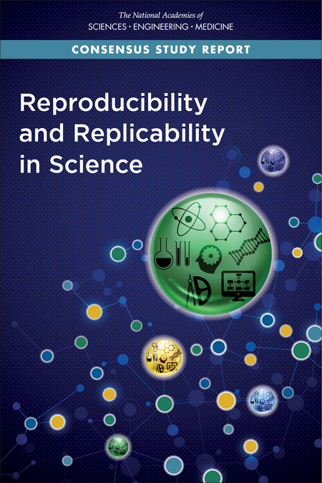
Reproducible vs Replicable: A Special Note
Historically different communities have defined these two differently
With the increased focus, there has also been an effort to unify the language
Consensus around the definitions of Claerbout, et al.
Others are in the process of switching their terminology to match, i.e., ACM
Reproducible: Another team is able to obtain the same result using the authors’ experimental environment
Replicable: Another team is able to obtain consistent results using a different experimental environment
doi:10.2172/1481626
doi:10.17226/25303

Slide 5
Why Reproducibility is Important
Notes:
Examples that resulted in disputed results
Additional Incentives
Ensure goals include credible science through better software
Limited resources
Data requirement plans for research
Reproducibility and transparency initiatives for publications

Slide 6
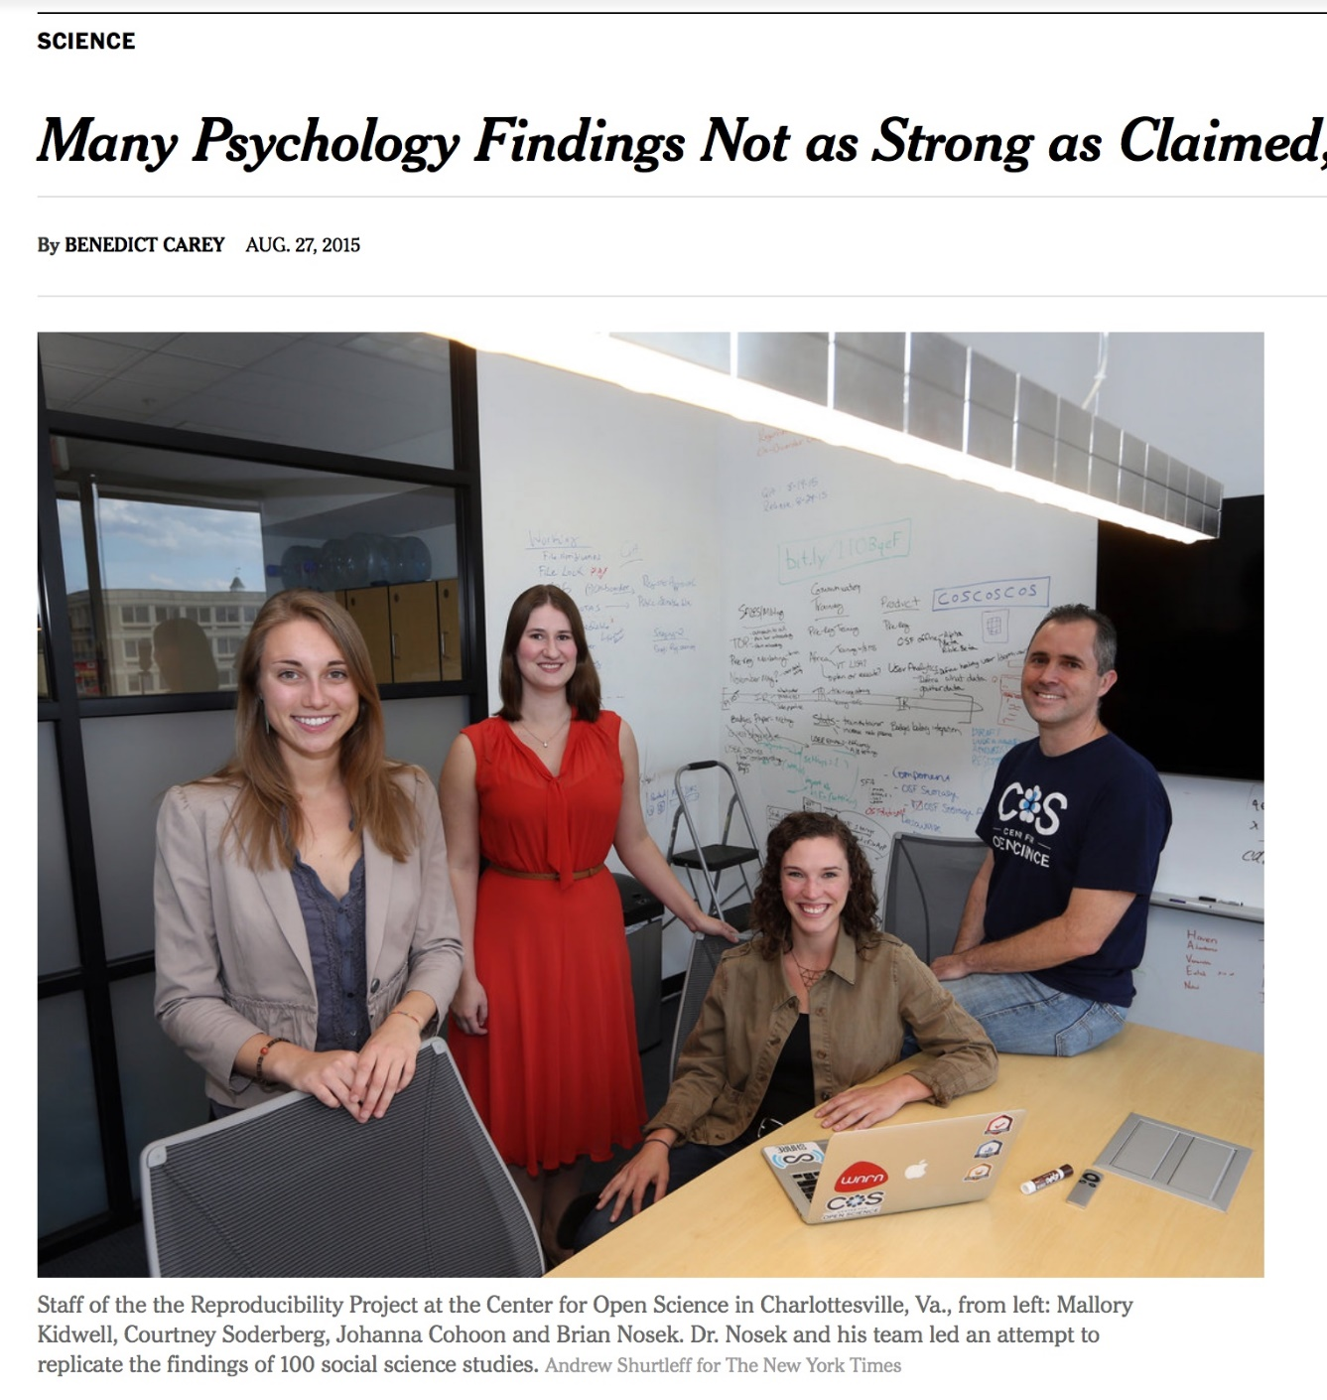
Transparency & Reproducibility
NY Times highlights “problems”.
Only one of many cited examples.
Computational science had been spared this “spotlight”.
http://www.nytimes.com/2015/08/28/science/many-social-science-findings-not-as-strong-as-claimed-study-says.html

Slide 7
Computational Science Example
Behavior of pure water just above homogeneous nucleation temperature (~ - 40 C/F).
Debenedetti/Princeton (2009):
2 possible phases: High or low density.
Chandler/Berkeley (2011):
Only 1 phase: High density.
No sharing of details across teams until 2016:
Chandler in Nature: “LAMMPS codes used in refs 5 and 12 are standard and documented, with scripts freely available upon request.”
Debenedetti with colleague Palmer: ”Send us your code.”
Received code after requests and appeal to Nature.
doi:10.1063/PT.6.1.20180822a

Slide 8
Computational Science Example
Palmer located bug/feature in Berkeley code.
Used to speed up LAMMPS execution.
Replaced with more standard approach.
Obtained result similar to Debenedetti 2009.
Resolution took 7 years.
For Palmer, the ordeal exemplifies the importance of transparency in scientific research, an issue that has recently drawn heightened attention in the science community. “One of the real travesties,” he says, is that “there’s no way you could have reproduced [the Berkeley team’s] algorithm—the way they had implemented their code—from reading their paper.” Presumably, he adds, “if this had been disclosed, this saga might not have gone on for seven years.”
doi:10.1063/PT.6.1.20180822a

Slide 9
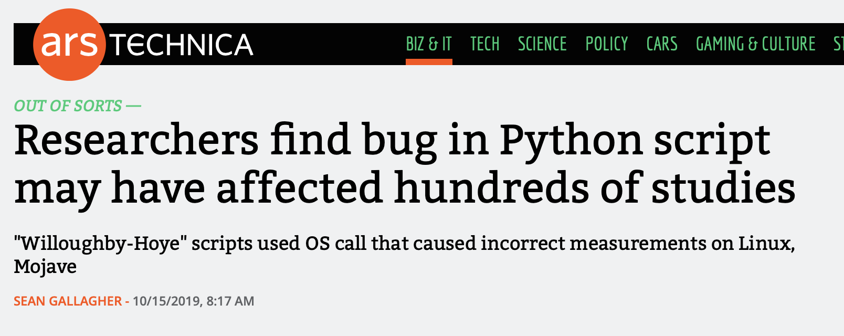
A Recent Example: Python Behaves Differently on Different Platforms
Scripts for analyzing experimental nuclear magnetic resonance (NMR) data
Scripts use Python's glob module (listing filenames matching a pattern)
Module ordered results differently in Linux and Mac Mojave
Results depended on the order in which files were processed
Casts doubt on results in 150 papers
Would a unit test have caught this?
https://arstechnica.com/information-technology/2019/10/chemists-discover-cross-platform-python-scripts-not-so-cross-platform/

Slide 10
Science through computing is, at best, as credible as the software that produces it!

Slide 11
Incentives for Paying Attention to Reproducibility
Common statement: “I would love to do a better job on my software, but I need to:
Get this paper submitted
Complete this project task
Do something my employer values more
Goal: Change incentives to include valuing of better software, better science
This is a long-term goal, requiring a culture change in (computational) science which is in the early stages

Slide 12

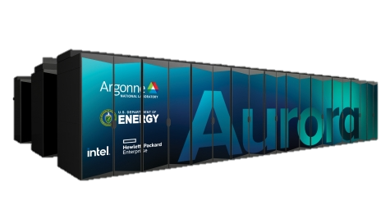
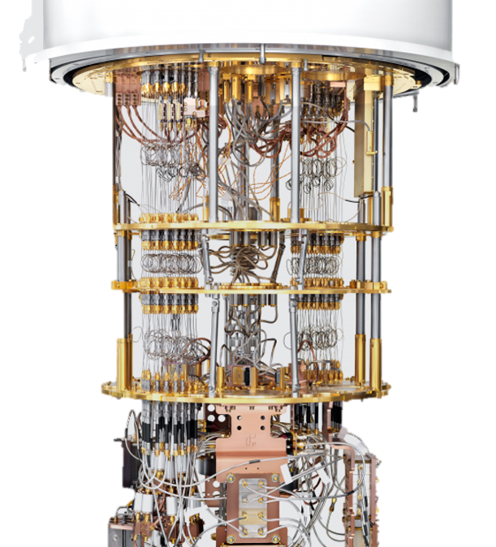
Supercomputer Cycles are Scarce Resources
No one wants to spend their precious allocation running simulations two or three times to be confident of the results
Though this ends up happening more than most people admit
And it could still be wrong!
But lots of people need to have confidence in your results
You
Your project lead or boss
Your sponsor
Your reviewers or referees
Your readers
Need to think about how to build credibility without repeating runs

Slide 13
Funders and the Community Setting Expectations for Your Data
Data Management Plans
FAIR Data Principles (gofair.us)
Most research sponsors require data management plans as part of proposals
Example: NSF policy on Dissemination and Sharing of Research Results
Promptly publish with appropriate authorship
Share data, samples, physical collections, and supporting materials with others, within a reasonable time frame
Share software and inventions
Investigators can keep their legal rights over their intellectual property, but they still have to make their results, data, and collections available to others
Policies will be implemented via
Proposal review
Award negotiations and conditions
Support/incentives
Address data producers and publishers to promote maximum use of research data
Findability
Data and supplementary materials have sufficiently rich metadata and a unique and persistent identifier.
Accessibility
Metadata and data are understandable to humans and machines. Data is deposited in a trusted repository.
Interoperability
Metadata use a formal, accessible, shared, and broadly applicable language for knowledge representation.
Reusability
Data and collections have a clear usage licenses and provide accurate information on provenance.

Slide 14
SC Conference Reproducibility Initiative
Two appendices:
Artifact description (AD)
Blue print for setting up your computational experiment
Makes it easier to rerun computations in future
AD appendix is mandatory for paper submissions (since SC19)
Largely auto-generated from submission information
For accepted papers, will be evaluated by reviewers
Artifact Evaluation (AE)
Targets “boutique” environments
Improves trustworthiness when re-running hard, impossible
Remains optional
Details: https://sc23.supercomputing.org/submit/reproducibility-initiative/

Slide 15
Increasing Attention on Reproducibility from Publishers
More publication venues are adding reproducibility recognition or requirements
ACM Replicated Reproducible Computational Results (RCR)
ACM TOMS, TOMACS
http://toms.acm.org/replicated-computational-results.cfm
ACM Badging
Functional, reusable, available, replicated, reproduced
https://www.acm.org/publications/policies/artifact-review-badging
These conferences have artifact evaluation appendices:
CGO, PPoPP, PACT, RTSS and SC
http://fursin.net/reproducibility.html
NISO Committee on Reproducibility and Badging
https://www.niso.org/niso-io/2019/01/new-niso-project-badging-scheme-reproducibility-computational-and-computing
Publishers: ACM, IEEE, figshare, STM, Reed Elsevier, Springer Nature

Slide 16
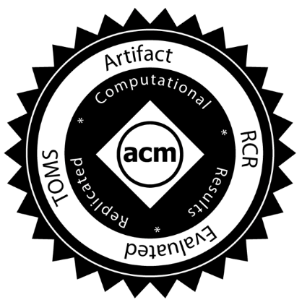
ACM TOMS Reproducible Computational Results (RCR)
Submission: Optional RCR option
Standard reviewer assignment: Nothing changes
RCR reviewer assignment:
Concurrent with standard reviews
As early as possible in review process
Known to and works with authors during the RCR process
RCR process:
Multi-faceted approach, Bottom line: Trust the reviewer
Publication:
Reproducible Computational Results Designation
The RCR referee acknowledged
Review report appears with published manuscript
Incentives:
Journal: raises the credibility/quality/rigor of papers it publishes
Authors: badging indicates additional credibility/quality/rigor of paper
Reviewer: companion publication

Slide 17
Creating a Virtuous Cycle
Demand
Transparency & Reproducibility Requirements
Productivity & Sustainability Investments
Enable
Reproducibility is, ultimately, based on good software development practices and good experimental practices

Slide 18
How to Improve Reproducibility

Slide 19
Strategies for Improving Reproducibility During Development (1/3)
Solid versioning practices are fundamental to reproducibility
Version control of code, documentation, and other artifacts
Frequent commits (perhaps to a separate development branch)
Provide versioning information in key output(s)
Version numbers (i.e., semantic versioning) are useful, but when do you increment them?
Automatic identifiers (i.e., git commit hash) are less ambiguous, but may not be as meaningful
Is the code you’re building modified from the version in the repository? (Not often done in practice)
Maintaining documentation (and other artifacts) in sync with code
You’ll forget
Or you won’t have (make) time to go back to it

Slide 20
Strategies for Improving Reproducibility During Development (2/3)
Build in quality from the start
Define and follow coding standards
Not just code style
Expectations for kinds and extent of documentation, types and rigor of tests
Develop tests as you code
Write tests while the code is fresh in your mind
Test Driven Development (TDD) means write tests before code, then code to pass the tests
Require increasingly rigorous testing as the code becomes more “public”
Testing has costs, need to balance level of risk against cost of creating and executing tests
Also think about frequency of tests at different levels of cost (c.f. continuous integration)
Practice peer code review
Per commit – should meet standards, and be understood and judged correct by reviewer
Pair experienced reviewers with less experienced coders to help ensure quality
Retrospective if you have a lot of existing unreviewed code

Slide 21
Strategies for Improving Reproducibility During Development (3/3)
Understand the numerics of your code
Floating point numbers are just approximations to real numbers
Many numerical methods have “quirks” too
If you’re using reduced- or mixed-precision computations, carefully compare with full-precision versions
On paper during development of the algorithms
Maybe provide an alternative full-precision computational path
Consider the possible effects of non-determinism due to concurrency
Floating point calculations done in different order may yield different results
Maybe useful to have an option to force deterministic computation
Look for testing/verification methods that don’t depend on bitwise reproducibility
Know your error bounds and develop tests against them
E.g., conservation rules apply to many physical quantities
Consider consulting subject matter experts for help

Slide 22
Strategies for Improving Reproducibility After Development
Testing, testing, and more testing!
Add “regression tests”
If you fix a bug, add a test to make sure that bug doesn’t creep back in
Add more tests
Be creative
Think about common cases, then corner cases
Think about misuse (unintentional or intentional)
Think about synthetic tests with synthetic data
Think about low-cost tests that can be “always on” (even if they’re not so stringent)
Can you detect silent data corruption?
Test your third-party dependencies
Are your tools doing what you think they’re doing?
What if you’re using a new version?
How do you decide if it is okay to upgrade to a new version?
Test your tests!
Make sure tests fail when they’re supposed to!
Thoroughly verify the code
Does the code do what you intended it to do?
On all relevant platforms (compilers, hardware, etc.)
Test regularly
To identify and document where changes to the underlying platform change code behavior/results

Slide 23
Digression – “Physics” (or Math)-Based Testing Strategies
Use what you know (or can construct) about the model you’re studying to test its implementation
Synthetic operators with known properties
Spectrum (huge diagonals)
Rank (by construction)
Invariance principles
Translational, rotational, etc.
Physical symmetries
Mathematical symmetries
Conservation rules
Fluxes, energy, mass, etc.
…

Slide 24
Digression – Design by Contract Programming
Building testing into your routines
To complement, not replace, other testing
The interface to a routine can be thought of as a contract between caller and the callee (the routine)
What does the routine expect on input? preconditions
What does the routine guarantee at completion? postconditions
What does the routine leave unchanged? invariants
Given valid inputs (preconditions satisfied) a routine should guarantee valid outputs (postconditions satisfied, invariants maintained)
If the preconditions are not satisfied, the routine should return an error
Emphasize low-costs tests that can be always-on
May need to be able to switch enforcement of expensive tests on/off (but try not to!)
Making the contract explicit facilitates correct use of routines
Especially when routine is reused in another context
Especially by those not intimately familiar with them

Slide 25
Strategies for Improving Reproducibility During Experiments (1/3)
What are you going to do, why, and how?
Plan your experiments thoroughly
If you’re in a team, designate one person to coordinate the experimental campaign
Know what you need (in the code, as inputs, as outputs to capture/analyze, etc.)
Know how you’re going to process or analyze the results
Know what to expect (in results, performance/cost, etc.)
How will you convince yourself that your results are trustworthy?
Perform pilot/test runs to build confidence in correctness, performance, scaling
Often useful to pursue an incremental/layered strategy
Ensure that you have the resources to store and/or analyze the outputs
What can you afford to archive?
What will you need to process and delete?
What will you need to process during execution or stream?

Slide 26
Strategies for Improving Reproducibility During Experiments (2/3)
Can you reproduce the code used for each and every experiment?
Three years later?
Use only well-defined versions of code (i.e., official “releases”, tags, etc.)
Main or development branches are often moving targets
Capture the exact version of the code used for each experiment
Is the code you’re building exactly what’s in the version control repo?
Don’t change versions during a related series of experiments (unless you have to)
If you have to change versions, know exactly what changed
Capture the exact version of the code used for each experiment
Use only versions of code that have been thoroughly verified
Continue to use regular testing to identify changes due to the underlying platform
E.g., compiler release introduces a new optimization that changes numerical results
Consider capturing version information of key libraries, compilers, and other dependencies used to build code
Not often done, in practice

Slide 27
Strategies for Improving Reproducibility During Experiments (3/3)
Be thorough in capturing provenance
Agents (codes), entities (inputs, outputs, etc.), activities (the transformation)
Capture code version
Capture all inputs/configuration information for each experiment
Use multiple systems to ensure that you can correctly associate inputs, outputs, and code versions
Systematic directory and file naming conventions
Separate written notes (paper notebook, electronic notebook)
Lab notebooks aren’t just for people who literally work in a laboratory!
Scripts to orchestrate experiments (versioned and captured)
Version control (if data is not too large)
Capture important outputs (as feasible)

Slide 28
Strategies for Improving Reproducibility After Experiments
Continue provenance capture through data analysis/reduction process
Agents (codes), entities (inputs, outputs, etc.), activities (the transformation)
Script as much of your analysis/reduction as possible
Prefer scriptable tools over those requiring human interaction
Keep them under version control
Document your process thoroughly
Separately from scripts, etc.
E.g., paper or electronic notebook
Especially where human interaction is required
Capture key intermediates in the reduction process
The more you capture, the more you will have for verification (and to find problems) later
Capture the data (in machine-readable form) used to produce graphs and tables
Expected by basic data management plans
And an increasing number of publishers

Slide 29
Tools May Help with Reproducibility
Just a small sampling…
Containers to capture the software
Resources for finding, understanding, and debugging floating point math problems: http://fpanalysistools.org/
Cloud platforms to publish and reproduce research code and data
E.g., https://CodeOcean.com
DOIs and hosting of data, code, documents, etc.
E.g., https://zenodo.org/, https://FigShare.com
Make sure to test and understand your tools thoroughly before using them for something important!

Slide 30
Summary
The credibility of your science derives from the credibility of your code (and process)
Science stakeholders are ratcheting up expectations for reproducibility
There are strategies to improve reproducibility in all phases of the scientific process
During development
After development
During experiments
After experiments
They amount to better software development practices
The same kinds of practices advocated for reasons of productivity, sustainability, maintainability, etc.

Slide 31
Other resources
The FAIR Guiding Principles for Scientific Data Management and Stewardship. Mark D. Wilkinson, et al. https://doi.org/10.1038/sdata.2016.18
FAIR for Research Software (FAIR4RS) Working Group: https://www.rd-alliance.org/groups/fair-research-software-fair4rs-wg
Editorial: ACM TOMS Replicated Computational Results Initiative. Michael A. Heroux. 2015. ACM Trans. Math. Softw. 41, 3, Article 13 (June 2015), 5 pages. DOI: http://dx.doi.org/10.1145/2743015
Enhancing Reproducibility for Computational Methods. Victoria Stodden, Marcia McNutt, David H. Bailey, Ewa Deelman, Yolanda Gil, Brooks Hanson, Michael A. Heroux, John P.A. Ioannidis, Michela Taufer Science (09 Dec 2016), pp. 1240-1241. DOI: 10.1126/science.aah6168
Simple experiments in reproducibility and technical trust by Mike Heroux and students (work in progress), https://betterscientificsoftware.github.io/Trust-Tools/
What every scientist should know about floating-point arithmetic. David Goldberg. https://doi.org/10.1145/103162.103163

